Slide 1
8086 Instruction Set
Roshan Fernandes, Dept of CSE, NMAMIT, Nitte

Slide 2
There are several types of instructions :
1. Data transfer instructions (including I/O transfers)
2. Binary arithmetic instructions
3. Decimal (BCD, ASCII) arithmetic instructions
4. Logical instructions
5. Shift and rotate instructions
6. Control transfer instructions
7. String instructions
8. Flag control instructions
9. Miscellaneous instructions
Roshan Fernandes, Dept of CSE, NMAMIT, Nitte

Slide 3
Data Transfer Instructions
Roshan Fernandes, Dept of CSE, NMAMIT, Nitte

Slide 4
Data Transfer instructions essentially copy the data and do not affect any flags (except of course the POPF instruction which modifies all the flags as per the stack top word)
Roshan Fernandes, Dept of CSE, NMAMIT, Nitte

Slide 5
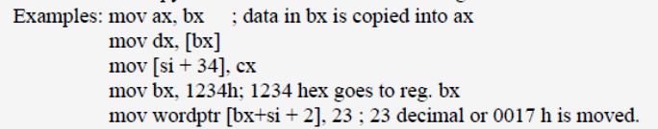
MOV
Stands for move, it is actually copy, that is, when data is moved from one register source to a destination register, source is not destroyed, only, there will be a copy of this data in the destination register
Roshan Fernandes, Dept of CSE, NMAMIT, Nitte

Slide 6

XCHG
Exchange instruction exchanges data between registers or between register and memory
Roshan Fernandes, Dept of CSE, NMAMIT, Nitte

Slide 7

PUSH
Push causes the data in the source register to be copied on to the stack top
Roshan Fernandes, Dept of CSE, NMAMIT, Nitte

Slide 8
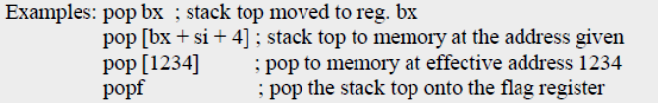
POP
Pop causes the stack top moved to (that is, removed from the stack and loaded onto) the destination register or memory specified by the instruction
Roshan Fernandes, Dept of CSE, NMAMIT, Nitte

Slide 9
IN
The IN instruction reads from an input port into AL or AX (only these two registers), to be specified in the instruction
The port address is generally in the register DX
But if it is 8-bits or less, then it can also be directly given in the instruction
Roshan Fernandes, Dept of CSE, NMAMIT, Nitte

Slide 10
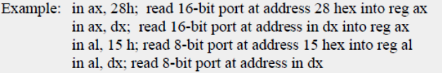
Roshan Fernandes, Dept of CSE, NMAMIT, Nitte

Slide 11
OUT
The OUT instruction outputs the data in register AX or AL (only) to be specified in the instruction to the output port indicated directly in the instruction if the port address is 8 bits or less, or in the register DX (for addresses 16 bits or less)
Roshan Fernandes, Dept of CSE, NMAMIT, Nitte

Slide 12
Examples:
out 16h, ax; write to output port at address 16h from reg. ax
out dx, ax; write to output port at address in dx from reg. ax
out 23h, al; write to output port at address 23h from reg al
out dx, al; write to output port at address in dx from reg al
Roshan Fernandes, Dept of CSE, NMAMIT, Nitte

Slide 13
CBW (Convert byte to word)
The source register AL and the destination AX are both implied and not specifically mentioned in this instruction
This instruction is used to extend the 8-bit integer (signed number) in reg. AL to 16- bit integer in AX
The process is called sign extension
Roshan Fernandes, Dept of CSE, NMAMIT, Nitte

Slide 14
If the number in AL is positive, AH will be loaded with 00 hex, else AH will be loaded with FF hex
Example: cbw
Roshan Fernandes, Dept of CSE, NMAMIT, Nitte

Slide 15
CWD (Convert Word to Double Word)
Convert word in reg. AX (implied and not stated in the instruction) to double word in regs. DX:AX (also implied and not stated)
That is, sign extend from AX into DX:AX
Example: cwd
Roshan Fernandes, Dept of CSE, NMAMIT, Nitte

Slide 16
Among all the data transfer instructions popf is the only instruction that affects and modifies the flags
Roshan Fernandes, Dept of CSE, NMAMIT, Nitte

Slide 17
Binary Arithmetic Instructions
Roshan Fernandes, Dept of CSE, NMAMIT, Nitte

Slide 18
All binary arithmetic instructions update the flag register based on the result of the operation performed
Roshan Fernandes, Dept of CSE, NMAMIT, Nitte

Slide 19
ADD
Adds the first operand (destination operand) and the second operand (source operand) and stores the result in the destination operand
The destination operand can be a register or a memory location; the source operand can be an immediate, a register, or a memory location
Two memory operands cannot be used in one instruction
Roshan Fernandes, Dept of CSE, NMAMIT, Nitte

Slide 20
When an immediate value is used as an operand, it is sign-extended to the length of the destination operand format
The ADD instruction performs integer addition
DEST ← DEST + SRC;
The OF, SF, ZF, AF, PF, and CF flags are set according to the result
Examples: ADD AX, BX
ADD [BX + 4], DX
ADD CX, 2[SI]
ADD DX, 123 H
Roshan Fernandes, Dept of CSE, NMAMIT, Nitte

Slide 21
ADC
Adds with carry
Same as ADD with the following change in the operation:
DEST ← DEST + SRC + CF;
The OF, SF, ZF, AF, PF, and CF flags are set according to the result
Roshan Fernandes, Dept of CSE, NMAMIT, Nitte

Slide 22
Example…
data segment
a db 0ABh
b db 0A5h
c dw ?
data ends
code segment
assume cs:code, ds:data
start:
mov ax, data
mov ds, ax
mov al, a
add al, b
mov ah, 00h
adc ah, 00h
mov c, ax
mov ah, 4ch
int 21h
code ends
end start
Roshan Fernandes, Dept of CSE, NMAMIT, Nitte

Slide 23
SUB
Subtraction
Follows the same rules as ADD with the following change in the operation:
DEST ← DEST – SRC;
The OF, SF, ZF, AF, PF, and CF flags are set according to the result
Roshan Fernandes, Dept of CSE, NMAMIT, Nitte

Slide 24
SBB
Subtract with borrow
Same as SUB with the following change in the operation:
DEST ← DEST – (SRC + CF);
The OF, SF, ZF, AF, PF, and CF flags are set according to the result
Roshan Fernandes, Dept of CSE, NMAMIT, Nitte

Slide 25
CMP
Compare two operands
Compares the first source operand with the second source operand and sets the status flags in the FLAGS register according to the results
The comparison is performed by subtracting the second operand from the first operand and then setting the status flags in the same manner as the SUB instruction
Roshan Fernandes, Dept of CSE, NMAMIT, Nitte

Slide 26
When an immediate value is used as an operand, it is sign extended to the length of the first operand
Operation:
temp ← SRC1 − SRC2;
In case an immediate value is used, then
temp ← SRC1 − Sign Extend (SRC2);
The CF, OF, SF, ZF, AF, and PF flags are set according to the result
Roshan Fernandes, Dept of CSE, NMAMIT, Nitte

Slide 27
Examples:
CMP AX, 24 H; (24 is sign extended to 16 bits before subtraction, because AX is a 16-bit register)
CMP BYTEPTR[BX], -24 H; (no sign extension done, data in bytes are being handled)
CMP BX, SI
CMP AL, [BX]; (BX will be taken only as a byte pointer, as AL is a byte register)
Roshan Fernandes, Dept of CSE, NMAMIT, Nitte

Slide 28
MUL
Performs an unsigned multiplication of the first operand (destination operand) and the second operand (source operand) and stores the result in the destination operand
The destination operand is an implied operand located in register AL or AX (depending on the size of the operand)
Roshan Fernandes, Dept of CSE, NMAMIT, Nitte

Slide 29
The source operand is located in a general-purpose register or a memory location
Operation:
  IF byte operation
  THEN
  AX ← AL ∗ SRC
  ELSE (* word operation *)
  DX:AX ← AX ∗ SRC
Roshan Fernandes, Dept of CSE, NMAMIT, Nitte

Slide 30
  Flags Affected
  The OF and CF flags are set to 0 if the upper half of
  the result is 0; otherwise, they are set to 1
  The SF, ZF, AF, and PF flags are undefined
  Examples:
  MUL BX
  MUL WORDPTR [BX + DI]48 H
  MUL BYTEPTR [SI]
  MUL CL
Roshan Fernandes, Dept of CSE, NMAMIT, Nitte

Slide 31
IMUL
Integer (signed) multiply
Similar to MUL, except the data are considered as signed integers
Flags are also affected similarly as for MUL
Roshan Fernandes, Dept of CSE, NMAMIT, Nitte

Slide 32
DIV
Divide the unsigned integer dividend in the accumulator by the unsigned integer divisor specified in the instruction
If the divisor specified is a word register or word memory, the dividend is considered to be the double word in DX:AX and the quotient of division will be in register AX, with the remainder in register DX and the divisor word specified in the instruction will not be altered
Roshan Fernandes, Dept of CSE, NMAMIT, Nitte

Slide 33
If the divisor specified in the instruction is a byte register or byte memory, then the accumulator will be the word register AX
The quotient of the division will be in AL register, and AH register will have the remainder
In case of word division, if the divisor word is not greater than the part of the dividend word in DX, then the quotient obviously will not fit into the register AX
Roshan Fernandes, Dept of CSE, NMAMIT, Nitte

Slide 34
Execution of DIV instruction in such a case will cause a division overflow exception to be generated, and operating system should take care of this exception
Roshan Fernandes, Dept of CSE, NMAMIT, Nitte

Slide 35
Examples of DIV instruction:
DIV BX;
DIV WORDPTR [DI];
DIV CL;
DIV BYTEPTR [SI];
Roshan Fernandes, Dept of CSE, NMAMIT, Nitte

Slide 36
IDIV
Integer divide, same as DIV but the data and the results are considered as signed integers
The CF, OF, SF, ZF, AF, and PF flags are undefined, when IDIV is executed
Roshan Fernandes, Dept of CSE, NMAMIT, Nitte

Slide 37
INC
Increment register or memory
This involves only a single operand
Adds 1 to the destination operand, while preserving the state of the CF flag
The destination operand can be a register or a memory location
Roshan Fernandes, Dept of CSE, NMAMIT, Nitte

Slide 38
This instruction allows a loop counter to be updated without disturbing the CF flag
If we use an ADD instruction with an immediate operand of 1 to perform an increment operation that does update the CF flag
Operation:
DEST ← DEST + 1;
The CF flag is not affected. The OF, SF, ZF, AF, and PF flags are set according to the result
Roshan Fernandes, Dept of CSE, NMAMIT, Nitte

Slide 39
DEC
Similar to INC, this instruction does the operation:
DEST ← DEST – 1;
The CF flag is not affected
The OF, SF, ZF, AF, and PF flags are set according to the result
Roshan Fernandes, Dept of CSE, NMAMIT, Nitte

Slide 40
NEG
Replaces the value of operand (the destination operand) with its two’s complement
This operation is equivalent to subtracting the operand from 0
The destination operand is located in a general-purpose register or a memory location
DEST ← – (DEST)
Roshan Fernandes, Dept of CSE, NMAMIT, Nitte

Slide 41
Flags Affected
The CF flag set to 0 if the source operand is 0; otherwise it is set to 1
The OF, SF, ZF, AF, and PF flags are set according to the result
Roshan Fernandes, Dept of CSE, NMAMIT, Nitte

Slide 42
Decimal (BCD, ASCII) Arithmetic Instructions
Roshan Fernandes, Dept of CSE, NMAMIT, Nitte

Slide 43
DAA: Decimal adjust accumulator for addition
Adjusts the sum of two packed BCD values to create a packed BCD result
The AL register is the implied source and destination operand
The DAA instruction is only useful when it follows an ADD instruction that adds (binary addition) two 2 - digit, packed BCD values and stores a byte result in the AL register
Roshan Fernandes, Dept of CSE, NMAMIT, Nitte

Slide 44
The DAA instruction then adjusts the contents of the AL register to contain the correct 2-digit, packed BCD result
If a decimal carry is detected, the CF and AF flags are set accordingly
If the lower nibble in AL after an addition is greater than 9 or AF was set by the addition, then the DAA instruction will add 6 to the lower nibble in AL
Roshan Fernandes, Dept of CSE, NMAMIT, Nitte

Slide 45
If the result in the upper nibble of AL is now greater then 9 or if the carry flag was set by the addition or correction, then DAA instruction will add 60H to AL
Roshan Fernandes, Dept of CSE, NMAMIT, Nitte

Slide 46
Example 1:
; AL = 0101 1001 = 59 BCD
; BL = 0011 0101 = 35 BCD
ADD AL, BL ; AL = 1000 1110 = 8EH
DAA ; Add 0110 Because 1110 > 9
; AL = 1001 0100 = 94 BCD
Roshan Fernandes, Dept of CSE, NMAMIT, Nitte

Slide 47
Example 2:
; AL = 1000 1000 = 88 BCD
; BL = 0100 1001 = 49 BCD
ADD AL, BL ; AL = 1101 0001, AF = 1
DAA ; Add 0110 because AF=1
; AL = 1101 0111 = D7H
; 1101 > 9 so add 0110 0000
; AL = 0011 0111 = 37 BCD, CF = 1
Roshan Fernandes, Dept of CSE, NMAMIT, Nitte

Slide 48
Flags affected
The CF and AF flags are set if the adjustment of the value results in a decimal carry in either digit of the result
The SF, ZF, and PF flags are set according to the result
The OF flag is undefined
Roshan Fernandes, Dept of CSE, NMAMIT, Nitte

Slide 49
DAS
Adjusts the result of the subtraction of two packed BCD values to create a packed BCD result
The AL register is the implied source and destination operand
The DAS instruction is only useful when it follows a SUB instruction that subtracts (binary subtraction) one 2-digit, packed BCD value from another and stores a byte result in the AL register
Roshan Fernandes, Dept of CSE, NMAMIT, Nitte

Slide 50
The DAS instruction then adjusts the contents of the AL register to contain the correct 2-digit, packed BCD result
If a decimal borrow is detected, the CF and AF flags are set accordingly
The CF and AF flags are set if the adjustment of the value results in a decimal borrow in either digit of the result
The SF, ZF, and PF flags are set according to the result. The OF flag is undefined
Roshan Fernandes, Dept of CSE, NMAMIT, Nitte

Slide 51
AAA: ASCII adjust AL after addition
Adjusts the sum of two unpacked BCD values to create an unpacked BCD result
The AL register is the implied source and destination operand for this instruction
The AAA instruction is only useful when it follows an ADD instruction that adds (binary addition) two unpacked BCD values and stores a byte result in the AL register
Roshan Fernandes, Dept of CSE, NMAMIT, Nitte

Slide 52
The AAA instruction then adjusts the contents of the AL register to contain the correct 1-digit unpacked BCD result
If the addition produces a decimal carry, the AH register increments by 1, and the CF and AF flags are set
If there was no decimal carry, the CF and AF flags are cleared and the AH register is unchanged
In either case, bits 4 through 7 of the AL register are set to 0
Roshan Fernandes, Dept of CSE, NMAMIT, Nitte

Slide 53
The AF and CF flags are set to 1 if the adjustment results in a decimal carry otherwise they are set to 0
The OF, SF, ZF, and PF flags are undefined
Example:
MOV AX, 15 ; AH = 00, AL = 0Fh
AAA ; now AH = 01, AL = 05
Roshan Fernandes, Dept of CSE, NMAMIT, Nitte

Slide 54
IF ((AL AND 0FH) > 9) OR (AF = 1)
THEN
AL ← AL + 6;
AH ← AH + 1;
AF ← 1;
CF ← 1;
ELSE
AF ← 0;
CF ← 0;
AL ← AL AND 0FH;
Roshan Fernandes, Dept of CSE, NMAMIT, Nitte

Slide 55
AAS: ASCII adjust AL after subtraction
Adjusts the result of the subtraction of two unpacked BCD values to create a unpacked BCD result
The AL register is the implied source and destination operand for this instruction
The AAS instruction is only useful when it follows a SUB instruction that subtracts (binary subtraction) one unpacked BCD value from another and stores a byte result in the AL
Roshan Fernandes, Dept of CSE, NMAMIT, Nitte

Slide 56
The AAA instruction then adjusts the contents of the AL register to contain the correct 1-digit unpacked BCD result
If the subtraction produced a decimal carry, the AH register decrements by 1, and the CF and AF flags are set. If no decimal carry occurred, the CF and AF flags are cleared, and the AH register is unchanged
In either case, the AL register is left with its top nibble set to 0
Roshan Fernandes, Dept of CSE, NMAMIT, Nitte

Slide 57
IF ((AL AND 0FH) > 9) OR (AF = 1)
THEN
AL ← AL – 6;
AH ← AH – 1;
AF ← 1;
CF ← 1;
ELSE
CF ← 0;
AF ← 0;
AL ← AL AND 0FH;
Roshan Fernandes, Dept of CSE, NMAMIT, Nitte

Slide 58
AAM: ASCII adjust AX after multiply
Adjusts the result of the multiplication of two unpacked BCD values to create a pair of unpacked (base 10) BCD values
The AX register is the implied source and destination operand for this instruction
The AAM instruction is only useful when it follows a MUL instruction that multiplies (binary multiplication) two unpacked BCD values and stores a word result in the AX register
Roshan Fernandes, Dept of CSE, NMAMIT, Nitte

Slide 59
The AAM instruction then adjusts the contents of the AX register to contain the correct 2-digit unpacked (base 10) BCD result
Operation:
tempAL ← AL;
AH ← tempAL / imm8; (imm8 is set to 0AH for the AAM mnemonic)
AL ← tempAL MOD imm8;
Roshan Fernandes, Dept of CSE, NMAMIT, Nitte

Slide 60
Example:
MOV AL, 15 ; AL = 0Fh
AAM ; AH = 01, AL = 05
Roshan Fernandes, Dept of CSE, NMAMIT, Nitte

Slide 61
AAD: ASCII adjust AX before division
Adjusts two unpacked BCD digits (the least significant digit in the AL register and the most significant digit in the AH register) so that a division operation performed on the result will yield a correct unpacked BCD value
The AAD instruction is only useful when it precedes a DIV instruction that divides (binary division) the adjusted value in the AX register by an unpacked BCD value
Roshan Fernandes, Dept of CSE, NMAMIT, Nitte

Slide 62
The AAD instruction sets the value in the AL register to (AL + (10 * AH)), and then clears the AH register to 00H
The value in the AX register is then equal to the binary equivalent of the original unpacked two digit (base 10) number in registers AH and AL
tempAL ← AL;
tempAH ← AH;
AL ← (tempAL + (tempAH ∗ imm8)) AND FFH; (* imm8 is set to 0AH for the AAD mnemonic *)
AH ← 0
Roshan Fernandes, Dept of CSE, NMAMIT, Nitte

Slide 63
Example:
MOV AX, 0105h ; AH = 01, AL = 05
AAD ; AH = 00, AL = 0Fh (15)
Note:
This instruction can be used to convert 2-digit unpacked BCD in AX to 2-digit packed hex in AL
Roshan Fernandes, Dept of CSE, NMAMIT, Nitte

Slide 64
Logical Instructions
Roshan Fernandes, Dept of CSE, NMAMIT, Nitte

Slide 65
AND
Performs a bitwise AND operation on the destination (first) and source (second) operands and stores the result in the destination operand location
The source operand can be an immediate, a register, or a memory location; the destination operand can be a register or a memory location
Roshan Fernandes, Dept of CSE, NMAMIT, Nitte

Slide 66
Each bit of the result is set to 1 if both corresponding bits of the first and second operands are 1; otherwise, it is set to 0
Operation:
DEST ← DEST AND SRC;
Flags Affected:
The OF and CF flags are cleared; the SF, ZF, and PF flags are set according to the result; The state of the AF flag is undefined
Roshan Fernandes, Dept of CSE, NMAMIT, Nitte

Slide 67
OR
Performs a bitwise inclusive OR operation between the destination (first) and source (second) operands and stores the result in the destination operand location
The source operand can be an immediate, a register, or a memory location; the destination operand can be a register or a memory location
Roshan Fernandes, Dept of CSE, NMAMIT, Nitte

Slide 68
Each bit of the result of the OR instruction is set to 0 if both corresponding bits of the first and second are 0; otherwise it is set to 1
Operation:
DEST ← DEST OR SRC;
Flags Affected:
The OF and CF flags are cleared; the SF, ZF, and PF flags are set according to the result; The state of the AF flag is undefined
Roshan Fernandes, Dept of CSE, NMAMIT, Nitte

Slide 69
XOR
Performs a bitwise exclusive OR (XOR) operation on the destination (first) and source (second) operands and stores the result in the destination operand location
The source operand can be an immediate, a register, or a memory location; the destination operand can be a register or a memory location
Roshan Fernandes, Dept of CSE, NMAMIT, Nitte

Slide 70
Each bit of the result is 1 if the corresponding bits of the operands are different; each bit is 0 if the corresponding bits are the same
Operation:
DEST ← DEST XOR SRC;
Flags Affected:
The OF and CF flags are cleared; the SF, ZF, and PF flags are set according to the result; The state of the AF flag is undefined
Roshan Fernandes, Dept of CSE, NMAMIT, Nitte

Slide 71
NOT
Performs a bitwise NOT operation (each 1 is set to 0, and each 0 is set to 1) or does 1’s complementing on the destination operand and stores the result in the destination operand location
The destination operand can be a register or a memory location
Roshan Fernandes, Dept of CSE, NMAMIT, Nitte

Slide 72
Operation:
DEST ← NOT DEST;
Flags Affected:
None
Roshan Fernandes, Dept of CSE, NMAMIT, Nitte

Slide 73
TEST
Bitwise AND the two sources operands, ignore the outcome, but preserve the nature of the result in the flag register
This instruction computes the bit-wise logical AND of first operand (source 1 operand) and the second operand (source 2 operand) and sets the SF, ZF, and PF status flags according to the result
The result is then discarded
Roshan Fernandes, Dept of CSE, NMAMIT, Nitte

Slide 74
Operation:
TEMP ← SRC1 AND SRC2;
SF ← MSB(TEMP);
IF TEMP = 0
THEN ZF ← 1;
ELSE ZF ← 0;
PF ← Parity of the lower 8-bits of TEMP;
CF ← 0;
OF ← 0;
(*AF is Undefined*)
Roshan Fernandes, Dept of CSE, NMAMIT, Nitte

Slide 75
Shift and Rotate
Instructions
Roshan Fernandes, Dept of CSE, NMAMIT, Nitte

Slide 76
Shift and rotate instructions shift the data by one or more bits towards either left or right, straight or in a circular fashion
The carry flag is always involved in these operations
Roshan Fernandes, Dept of CSE, NMAMIT, Nitte

Slide 77
Shift Instructions…
Shift instructions position or move numbers to the left or right within a register or memory location
Two are logical shifts and two are arithmetic shifts
Roshan Fernandes, Dept of CSE, NMAMIT, Nitte

Slide 78
The logical shifts move a 0 into the rightmost bit position for a logical left shift and a 0 into the leftmost bit position for a logical right shift
The arithmetic and logical left shifts are identical
Roshan Fernandes, Dept of CSE, NMAMIT, Nitte

Slide 79
The arithmetic and logical right shifts are different because the arithmetic right shift copies the sign-bit through the number, while the logical right shift copies a 0 through the number
Logical shift operations function with unsigned numbers, and arithmetic shifts function with signed numbers
Roshan Fernandes, Dept of CSE, NMAMIT, Nitte

Slide 80
Logical shifts multiply or divide unsigned data, and arithmetic shifts multiply or divide signed data
A shift left always multiplies by 2 for each bit position shifted, and a shift right always divides by 2 for each bit position shifted
Roshan Fernandes, Dept of CSE, NMAMIT, Nitte

Slide 81
The logical shift instructions are SHL, SHR
The arithmetic shift instructions are SAL, SAR
Roshan Fernandes, Dept of CSE, NMAMIT, Nitte

Slide 82
SHL – Shift Operand Bits Left, Put Zero in LSBs
SHL Destination, Count
Roshan Fernandes, Dept of CSE, NMAMIT, Nitte

Slide 83
As a bit is shifted out of the LSB position, a zero is put in the LSB position
The MSB will be shifted to CF
CF ← MSB LSB ← 0
Roshan Fernandes, Dept of CSE, NMAMIT, Nitte

Slide 84
If the desired number of shifts is 1, this can be specified by putting a 1 in the count position of the instruction
For shifts of more than 1 bit position, the desired number of shifts is loaded into the CL register
Example:
MOV CL, 05H
SHL AX, CL
Roshan Fernandes, Dept of CSE, NMAMIT, Nitte

Slide 85
SAL – Shift Operand Bits Left, Put Zero in LSBs
SAL Destination, Count
Roshan Fernandes, Dept of CSE, NMAMIT, Nitte

Slide 86
As a bit is shifted out of the LSB position, a zero is put in the LSB position
The MSB will be shifted to CF
CF ← MSB LSB ← 0
Roshan Fernandes, Dept of CSE, NMAMIT, Nitte

Slide 87
If the desired number of shifts is 1, this can be specified by putting a 1 in the count position of the instruction
For shifts of more than 1 bit position, the desired number of shifts is loaded into the CL register
Example:
MOV CL, 05H
SAL AX, CL
Roshan Fernandes, Dept of CSE, NMAMIT, Nitte

Slide 88
SHR – Shift Operand Bits Right, New MSB = 0
SHR Destination, Count
Roshan Fernandes, Dept of CSE, NMAMIT, Nitte

Slide 89
This instruction shifts each bit in the specified destination some number of bit positions to the right
As a bit is shifted out of the MSB position, 0 is put in the MSB position
The LSB will be shifted into CF
Roshan Fernandes, Dept of CSE, NMAMIT, Nitte

Slide 90
0 → MSB LSB → CF
Roshan Fernandes, Dept of CSE, NMAMIT, Nitte

Slide 91
If the desired number of shifts is 1, this can be specified by putting a 1 in the count position of the instruction
For shifts of more than 1 bit position, the desired number of shifts is loaded into the CL register
Example:
MOV CL, 03H
SHR AL, CL
Roshan Fernandes, Dept of CSE, NMAMIT, Nitte

Slide 92
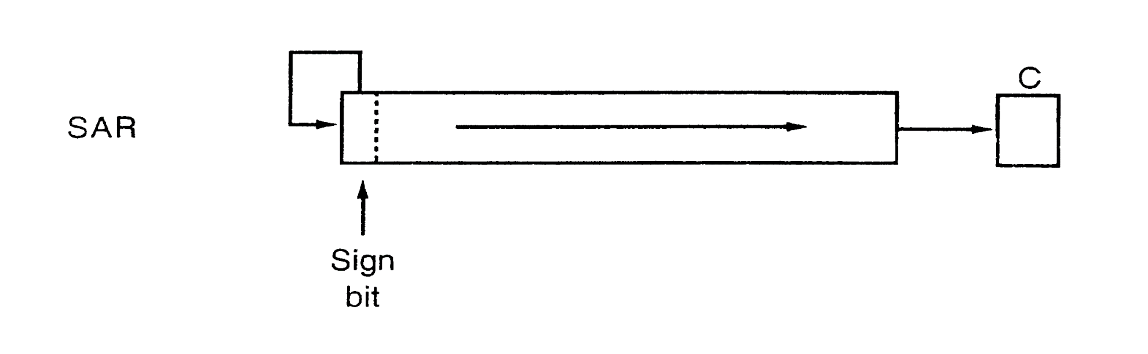
SAR
Roshan Fernandes, Dept of CSE, NMAMIT, Nitte

Slide 93
This Arithmetic shift right instruction copies the sign bit through the number
SAR Destination, Count
Roshan Fernandes, Dept of CSE, NMAMIT, Nitte

Slide 94
If the desired number of shifts is 1, this can be specified by putting a 1 in the count position of the instruction
For shifts of more than 1 bit position, the desired number of shifts is loaded into the CL register
Example:
MOV CL, 03H
SAR AL, CL
Roshan Fernandes, Dept of CSE, NMAMIT, Nitte

Slide 95
ROL – Rotate Al Bits of Operand Left, MSB to LSB
ROL Destination, Count
This instruction rotates all the bits in a specified word or byte to the left some number of bit positions
CF← MSB LSB
Roshan Fernandes, Dept of CSE, NMAMIT, Nitte

Slide 96
If the desired number of shifts is 1, this can be specified by putting a 1 in the count position of the instruction
For shifts of more than 1 bit position, the desired number of shifts is loaded into the CL register
Example:
MOV CL, 03H
ROL AL, CL
Roshan Fernandes, Dept of CSE, NMAMIT, Nitte

Slide 97
ROR – Rotate Al Bits of Operand Right, LSB to MSB
ROR Destination, Count
This instruction rotates all the bits in a specified word or byte to the right some number of bit positions
CF MSB LSB
Roshan Fernandes, Dept of CSE, NMAMIT, Nitte

Slide 98
If the desired number of shifts is 1, this can be specified by putting a 1 in the count position of the instruction
For shifts of more than 1 bit position, the desired number of shifts is loaded into the CL register
Example:
MOV CL, 03H
ROR AL, CL
Roshan Fernandes, Dept of CSE, NMAMIT, Nitte

Slide 99
For the ROL and ROR instructions, the original value of the CF flag is not a part of the result, but the CF flag receives a copy of the bit that was shifted from one end to the other
Roshan Fernandes, Dept of CSE, NMAMIT, Nitte

Slide 100
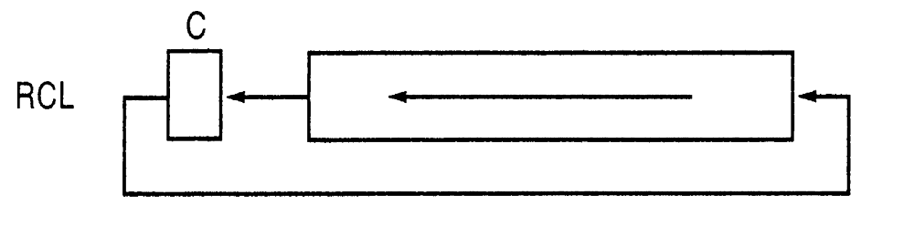
RCL (Rotate Left including carry)
The RCL instruction shifts the CF flag into the least-significant bit and shifts the most significant bit into the CF flag
Roshan Fernandes, Dept of CSE, NMAMIT, Nitte

Slide 101
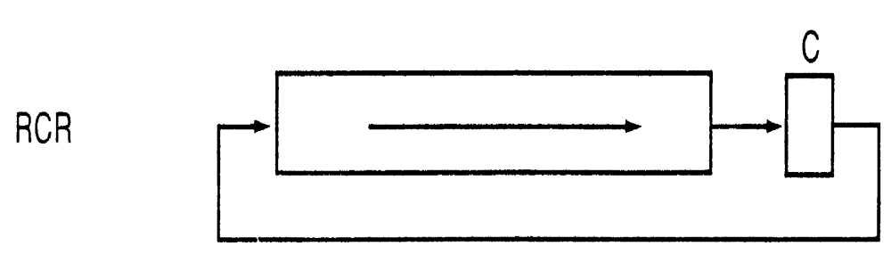
RCR (Rotate Right including carry)
The RCR instruction shifts the CF flag into the most-significant bit and shifts the least- significant bit into the CF flag
Roshan Fernandes, Dept of CSE, NMAMIT, Nitte

Slide 102
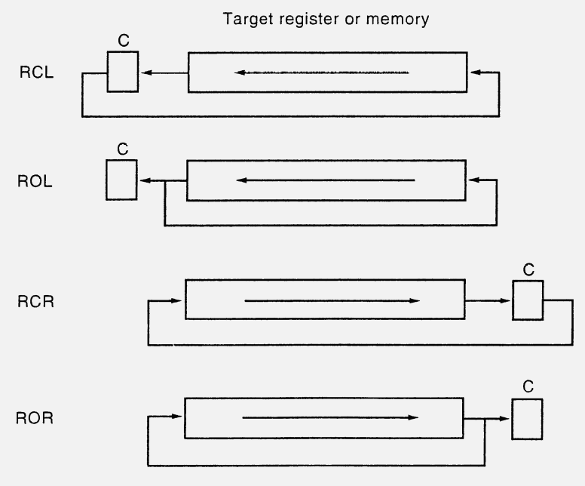
Roshan Fernandes, Dept of CSE, NMAMIT, Nitte

Slide 103
Control Transfer
Instructions
Roshan Fernandes, Dept of CSE, NMAMIT, Nitte

Slide 104
The intelligence in any program lies in the ability of the program to follow different courses of action based on intermediate results produced during the working of the program; that way, the program is enabled to perform data sensitive tasks
This capability is obtained by context sensitive jump operations, in contrast to the normal sequential cyclical operation of fetching the next instruction and executing it, in the order in which it is found in the program
Roshan Fernandes, Dept of CSE, NMAMIT, Nitte

Slide 105
JMP: Jump instruction
Transfers program control to a different point in the instruction stream without recording return information
This instruction can be used to execute three different types of jumps: Near Jump, Short Jump and Far Jump…
Roshan Fernandes, Dept of CSE, NMAMIT, Nitte

Slide 106
Near jump—A jump to an instruction within the current code segment (the segment currently pointed to by the CS register), sometimes referred to as an intra segment jump
Short jump—A near jump where the jump range is limited to –128 to +127 from the current IP value
Far jump—A jump to an instruction located in a different segment than the current code segment, is sometimes referred to as an inter segment jump
The CS register is not changed on near and short jumps…
Roshan Fernandes, Dept of CSE, NMAMIT, Nitte

Slide 107
Conditional Jump Instructions…
Roshan Fernandes, Dept of CSE, NMAMIT, Nitte

Slide 108
MNEMONIC | CONDITION TESTED
JA/JNBE | (CF OR ZF) =0
JAE/JNB | CF=0
JB/JNAE | CF=1
JBE/JNA | (CF OR ZF)=1
JC | CF = 1
JE/JZ | ZF = 1
JG/JNLE | ((SF XOR OF) OR ZF ) =0
Roshan Fernandes, Dept of CSE, NMAMIT, Nitte

Slide 109
MNEMONIC | CONDITION TESTED
JGE/JNL | (SF XOR OF)=0
JL/JNGE | (SF XOR OF)=1
JLE/JNG | ((SF XOR OF) OR ZF )=1
JNC | CF=0 (not carry)
JNE/JNZ | ZF=0
JNO | OF=0 (not overflow)
JNP/JPO | PF=0 (not parity/parity odd)
JNS | SF=0 (not sign)
Roshan Fernandes, Dept of CSE, NMAMIT, Nitte

Slide 110
MNEMONIC | CONDITION TESTED
JO | OF=1 (overflow)
JP/JPE | PF (Parity / parity equal)
JS | SF=1 (Sign)
Roshan Fernandes, Dept of CSE, NMAMIT, Nitte

Slide 111
LOOP Instruction
The LOOP instructions are basically conditional jump instructions which have the format
  LOOP LABEL
Roshan Fernandes, Dept of CSE, NMAMIT, Nitte

Slide 112
LOOP instruction combines 2 operations in each instruction
The first operation is to decrement the CX register by 1
The second operation is to check the CX register and, in some cases, also the zero flag to decide whether to do a jump to the specified label
Roshan Fernandes, Dept of CSE, NMAMIT, Nitte

Slide 113
LOOP | Loop Until CX=0
LOOPE / LOOPZ | Loop if zero flag is set and CX !=0
LOOPNE / LOOPNZ | Loop if zero flag not set and CX !=0
JCXZ | Jump if CX = 0
Roshan Fernandes, Dept of CSE, NMAMIT, Nitte

Slide 114
CALL
Call instruction is a returnable jump to the destination or the target address provided in the instruction
This instruction can be used to execute two different types of calls:
Near call — A call to a procedure within the current code segment (the segment currently pointed to by the CS register), sometimes referred to as an intra segment call
Far call — A call to a procedure located in a different segment than the current code segment, sometimes referred to as an inter segment call
Roshan Fernandes, Dept of CSE, NMAMIT, Nitte

Slide 115
When executing a near call, the processor pushes the value of the IP register (which contains the offset of the instruction following the CALL instruction) onto the stack (for use later as a return-instruction pointer)
The processor then branches to the address in the current code segment specified with the target operand
The CS register is not changed on near calls
Roshan Fernandes, Dept of CSE, NMAMIT, Nitte

Slide 116
When executing a far call, the processor pushes the current value of both the CS and IP registers onto the stack for use as a return-instruction pointer
The processor then performs a “far branch” to the code segment and offset specified with the target operand for the called procedure
Roshan Fernandes, Dept of CSE, NMAMIT, Nitte

Slide 117
RET
The RET (return) instruction returns control back from the procedure to the program that has called the procedure
The control will be returned to the instruction following the procedure call
This instruction transfers program control to a return address located on the top of the stack
Roshan Fernandes, Dept of CSE, NMAMIT, Nitte

Slide 118
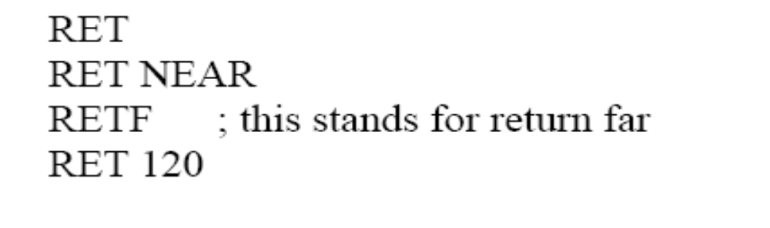
The address is usually placed on the stack by a CALL instruction, and the return is made to the instruction that follows the CALL instruction
The optional source operand specifies the number of stack bytes to be released after the return address is popped; the default is none
Roshan Fernandes, Dept of CSE, NMAMIT, Nitte

Slide 119
INT n
These instructions are software interrupt procedure calls
Software interrupts are special procedures that can be invoked or called using an 8-bit number, known as the interrupt number
Many system services are rendered using software interrupts
The interrupt invoked procedures are normally known as interrupt service routines
Roshan Fernandes, Dept of CSE, NMAMIT, Nitte

Slide 120
I/O devices also can obtain system services using these calls
They first get the attention of the processor by activating the interrupt pin of the processor
When the pin is activated, the processor goes through a sequence of operations to which the interrupting I/O device responds by inputting an 8-bit number n
The processor then invokes the service routine for INT n
This process is known as the hardware interrupt operation
Roshan Fernandes, Dept of CSE, NMAMIT, Nitte

Slide 121
Once an interrupt is invoked, the processor pushes the FLAGS, the CS and the IP value
With this, the processor is ready to accept a returnable far jump (new values in CS and IP, returnable because the old values of CS and IP are stored in the stack along with the old flags)
Roshan Fernandes, Dept of CSE, NMAMIT, Nitte

Slide 122
The destination operand n in the instruction specifies an interrupt vector number from 0 to 255, encoded as an 8-bit unsigned intermediate value
Each interrupt vector number n provides an index to a 4-byte array – the interrupt vector array – storing the far call address associated with the particular n
Roshan Fernandes, Dept of CSE, NMAMIT, Nitte

Slide 123
In all, there is provision for 256 interrupts, and with each interrupt having a 4 byte address (far call address CS and IP), the interrupt vector array is placed in the lowest 1 KB of the memory space
The first 32 interrupt vector numbers are reserved by Intel for system use
Some of these interrupts are used for internally generated exceptions
Roshan Fernandes, Dept of CSE, NMAMIT, Nitte

Slide 124
IRET: Return from interrupt
The IRET instruction performs a far return to the interrupted program or procedure
During this operation, the processor pops the return instruction pointer, return code segment selector, and FLAGS image from the stack to the IP, CS, and FLAGS registers, respectively, and then resumes execution of the interrupted program or procedure
Roshan Fernandes, Dept of CSE, NMAMIT, Nitte

Slide 125
String Instructions
Roshan Fernandes, Dept of CSE, NMAMIT, Nitte

Slide 126
The 8086 String Instructions
Moving a String:
REPEAT
MOVE BYTE FROM SOURCE STRING
TO DESTINATION STRING
UNTIL ALL BYTES MOVED
Roshan Fernandes, Dept of CSE, NMAMIT, Nitte

Slide 127
The more detailed algorithm is as follows:
INITIALIZE SOURCE POINTER, SI
INITIALIZE DESTINATION POINTER, DI
INITIALZE COUNTER, CX
REPEAT
COPY BYTE FROM SOURCE TO
DESTINATION
INCREMENT SOURCE POINTER
INCREMENT DESTINATION POINTER
DECREMENT COUNTER
UNTIL COUNTER = 0
Roshan Fernandes, Dept of CSE, NMAMIT, Nitte

Slide 128
The single 8086 string instruction MOVSB, will perform all the actions in the REPEAT-UNTIL loop
The MOVSB instruction will copy a byte from the location pointed to by the SI register to a location pointed to by DI register
It will then automatically increment/decrement SI and DI to point to the next source location
Roshan Fernandes, Dept of CSE, NMAMIT, Nitte

Slide 129
If you add a special prefix called the repeat prefix ( REP ) in front of the MOVSB instruction, the MOVSB instruction will be repeated and CX decremented until CX is counted down to zero
In order for the MOVSB instruction to work correctly, the source index register, SI, must contain the offset of the start of the source string and the destination index register, DI, must contain the offset of the start of the destination location
Roshan Fernandes, Dept of CSE, NMAMIT, Nitte

Slide 130
Also, the number of string elements to be moved must be loaded into the CX register
The string instructions will automatically increment or decrement the pointers after each operation, depending on the state of the direction flag DF
Roshan Fernandes, Dept of CSE, NMAMIT, Nitte

Slide 131
If the direction flag is cleared with a CLD instruction, then the pointers in SI and DI will be automatically be incremented after each string operation
If the direction flag is set with an STD instruction, then the pointers in SI and DI will be automatically be decremented after each string operation
Roshan Fernandes, Dept of CSE, NMAMIT, Nitte

Slide 132
Note:
For String instructions, an offset in DI is added to the segment base represented by the number in the ES register to produce a physical address
If DS and ES are initialized with the same value, then SI and DI will point to locations in the same segment
Roshan Fernandes, Dept of CSE, NMAMIT, Nitte

Slide 133
Example…
DATA SEGMENT
TEST_MSG DB ‘HELLO’
DB 100 DUP(?)
NEW_LOC DB 5 DUP(0)
DATA ENDS
CODE SEGMENT
ASSUME CS:CODE, DS:DATA, ES:DATA
START: MOV AX, DATA
MOV DS, AX
MOV ES, AX
Roshan Fernandes, Dept of CSE, NMAMIT, Nitte

Slide 134
LEA SI, TEST_MSG
LEA DI, NEW_LOC
MOV CX, 05
CLD
REP MOVSB
MOV AH, 4CH
INT 21H
CODE ENDS
END START
Roshan Fernandes, Dept of CSE, NMAMIT, Nitte

Slide 135
Note:
The MOVSW instruction can be used to move a string of words; Depending on the state of the direction flag, SI and DI will automatically be incremented or decremented by 2 after each word move
If the REP prefix is used, CX will be decremented by 1 after each word move, so CX should be initialized with the number of words in the string
Roshan Fernandes, Dept of CSE, NMAMIT, Nitte

Slide 136
Advantage of using MOVSB/MOVSW:
The string instruction is much more efficient than using a sequence of standard instructions, because the 8086 only has to fetch and decode the REP MOVSB instruction once
A standard instruction sequence such as MOV, MOV, INC, INC, LOOP etc would have to be fetched and decoded each time around the loop
Roshan Fernandes, Dept of CSE, NMAMIT, Nitte

Slide 137
Using the CMPSB (Compare String Byte)
The CMPSB instruction will compare the byte pointed to by SI with the byte pointed to by DI and set the flags according to the result
It also increment/decrement the pointers SI and DI (depending on DF) to point to the next string elements
Roshan Fernandes, Dept of CSE, NMAMIT, Nitte

Slide 138
The REPE prefix in front of this instruction tells the 8086 to decrement the CX register after each compare, and repeat the CMPSB instruction if the compared bytes were equal AND CX is not yet decremented down to zero
Roshan Fernandes, Dept of CSE, NMAMIT, Nitte

Slide 139
Example
DATA SEGMENT
STR1 DB ‘HELLO’
STR2 DB ‘HELLO’
DATA ENDS
CODE SEGMENT
ASSUME CS:CODE, DS:DATA, ES:DATA
START: MOV AX, DATA
MOV DS, AX
MOV ES, AX
Roshan Fernandes, Dept of CSE, NMAMIT, Nitte

Slide 140
LEA SI, STR1
LEA DI, STR2
MOV CX, 05
CLD
REPE CMPSB
JNE NOTEQUAL
; DISPLAY EQUAL
JMP EXIT
NOTEQUAL:
; DISPLAY NOT EQUAL
EXIT: MOV AH, 4CH
INT 21H
CODE ENDS
END START
Roshan Fernandes, Dept of CSE, NMAMIT, Nitte

Slide 141
SCASB, SCASW (Scan string byte, scan string word)
This instruction is the same as the earlier CMPSB, CMPSW instructions, except for the fact that the source for comparison is the register AL for SCASB, or AX for SCASW
The destination is the same, namely, ES:DI, and on execution, DI will point to the next byte or word, based on the instruction and the direction flag as in the earlier cases
Roshan Fernandes, Dept of CSE, NMAMIT, Nitte

Slide 142
With CX initialized to the length of the destination array, and DI initialized to the array start address when D flag is reset, or to the end address of the array when the D flag is set, we can use the conditional instruction prefixes REPE (REPZ) or REPNE (REPNZ)
The repetition will then go on until the condition gets contradicted or until the register CX reaches zero (that is, the destination array is completed)
Roshan Fernandes, Dept of CSE, NMAMIT, Nitte

Slide 143
LODSB, LODSW: Load string byte, load string word
These instructions are similar to MOVSB, MOVSW except the destination of the move becomes AL for LODSB, and AX for LODSW
The source is DS:SI
On execution the data will come to the register AL or AX, and SI will be properly modified
The REP or REPE (REPZ) prefix are like in the MOVES instructions
Roshan Fernandes, Dept of CSE, NMAMIT, Nitte

Slide 144
STOSB, STOSW: Store string word, store string word
Similar to LODS, except the source is the accumulator, AL for byte store and AX for word store operations
The destination is ES:DI
The destination address modification after execution and repeat loop with CX initialized and using REP (REPE, REPZ) prefix will work like in LODS instructions
Roshan Fernandes, Dept of CSE, NMAMIT, Nitte

Slide 145
This can be used to initialize a memory block with a fixed data as shown in the assembly language program segment below:
MOV CX, 100H
MOV DI, 500H
MOV AX, 0
REP STOSW
This program segment when executed will clear memory from address ES:500 to ES:7FF inclusive (100 words from address 500)
Roshan Fernandes, Dept of CSE, NMAMIT, Nitte

Slide 146
Flag Control Instructions
Roshan Fernandes, Dept of CSE, NMAMIT, Nitte

Slide 147
STC, CLC and CMC (Set Carry, Clear Carry and Complement Carry)
STC operation: CF ← 1;
CLC operation: CF ← 0;
CMC operation: CF ← NOT CF
No other flags are affected by these instructions
Roshan Fernandes, Dept of CSE, NMAMIT, Nitte

Slide 148
STD and CLD (Set and Clear Direction Flag)
STD operation: DF ← 1; enables string addresses to be decremented
CLD operation: DF ← 0; enables string addresses to be incremented
Other flags are not affected by these instructions
Roshan Fernandes, Dept of CSE, NMAMIT, Nitte

Slide 149
STI and CLI
These instructions modify the Interrupt control flag in the flag register
When this I flag is set, the processor is enabled to accept the hardware interrupts
Otherwise when it is reset, the processor will not be interrupted by activating the interrupt pin of the processor from the external hardware
Software interrupts are not disabled by clearing the I flag
Roshan Fernandes, Dept of CSE, NMAMIT, Nitte

Slide 150
STI operation: IF ← 1; Hardware interrupts enabled
CLI operation: IF ← 0; Hardware interrupts disabled
Roshan Fernandes, Dept of CSE, NMAMIT, Nitte

Slide 151
LAHF
Load flag register (lower byte) to register AH
This is flag register move instruction
Roshan Fernandes, Dept of CSE, NMAMIT, Nitte

Slide 152
SAHF
Store the contents of AH register into the lower byte of Flag register
Loads the SF, ZF, AF, PF, and CF flags of the FLAGS register with values from the corresponding bits in the AH register (bits 7, 6, 4, 2, and 0, respectively)
Bits 1, 3, and 5 of register AH are ignored
Roshan Fernandes, Dept of CSE, NMAMIT, Nitte

Slide 153
PUSHF and POPF
PUSHF pushes flag register onto stack
POPF pops top of the stack content into flag register
Roshan Fernandes, Dept of CSE, NMAMIT, Nitte

Slide 154
Miscellaneous Instructions
Roshan Fernandes, Dept of CSE, NMAMIT, Nitte

Slide 155
LEA (Load Effective Address)
This instruction computes the effective address of the second operand (the source operand) and stores it in the first operand (destination operand)
The source operand is a memory address (offset part) specified with one of the processors addressing modes; the destination operand is one of the 8 registers AX, BX, CX, DX, SI, DI, BP or SP
Roshan Fernandes, Dept of CSE, NMAMIT, Nitte

Slide 156
NOP: No operation
This is a one byte instruction doing nothing except incrementing the IP by 1
It can also be coded in the assembly language as XCHG AX, AX, which also does nothing really
The machine code for XCHG AX, AX and NOP are the same; both are 90 H
Roshan Fernandes, Dept of CSE, NMAMIT, Nitte

Slide 157
XLAT – Translate a Byte in AL
This instruction is used to translate a byte from one code to another code
The instruction replaces a byte in the AL register with a byte pointed to by BX in a lookup table in memory
Before the XLAT instruction can be executed, the lookup table containing the values for the new code must be put in memory and the offset of the starting address of the lookup table must be loaded in BX
Roshan Fernandes, Dept of CSE, NMAMIT, Nitte

Slide 158
The code byte to be translated is put in AL
To point to the desired byte in the lookup table, the XLAT instruction adds the byte in AL to the offset of the start of the table in BX
It then copies the byte from the address pointed to by (BX+AL) back into AL
XLAT changes no flags
Roshan Fernandes, Dept of CSE, NMAMIT, Nitte

Slide 159
Example:
; 8086 routine to convert ASCII code byte
; to EBCDIC equivalent
; ASCII code byte is in AL at start
; EBCDIC code in AL at end
MOV BX, OFFSET EBCDIC_TABLE
;Point BX at start of EBCDIC table in DS
XLAT
; Replace ASCII in AL with EBCDIC from table
Roshan Fernandes, Dept of CSE, NMAMIT, Nitte

Slide 160
Assembler Directives
Roshan Fernandes, Dept of CSE, NMAMIT, Nitte

Slide 161
ASSUME
DB – Define Byte
DW – Define Word
DD – Define Double Word
Roshan Fernandes, Dept of CSE, NMAMIT, Nitte

Slide 162
DQ – Define Quadword
Tell the assembler to declare a variable 4 words in length or to reserve 4 words of storage in memory
Example:
BIG_NUMBER DQ 243598740192A92BH
Roshan Fernandes, Dept of CSE, NMAMIT, Nitte

Slide 163
DT – Define Ten Bytes
Tells the assembler to define a variable which is 10 bytes in length or to reserve 10 bytes of storage in memory
Example:
BIG_NUMBER DT 458733740192A92B8865H
Roshan Fernandes, Dept of CSE, NMAMIT, Nitte

Slide 164
END – End Program
Last statement of a program to tell the assembler that this is the end of the program module
The assembler will ignore any statements after an END directive
Roshan Fernandes, Dept of CSE, NMAMIT, Nitte

Slide 165
ENDP – End Procedure
This directive is used along with the name of the procedure to indicate the end of a procedure to the assembler
Roshan Fernandes, Dept of CSE, NMAMIT, Nitte

Slide 166
ENDS – End Segment
This directive is used with the name of a segment to indicate the end of that logical segment
Roshan Fernandes, Dept of CSE, NMAMIT, Nitte

Slide 167
EQU – Equate
Is used to give a name to some value or symbol
Each time the assembler finds the given name in the program, it will replace the name with the value or symbol you equated with that name
Roshan Fernandes, Dept of CSE, NMAMIT, Nitte

Slide 168
EVEN – Align on Even Memory Address
The EVEN directive tells the assembler to increment the location counter to the next even address if it is not already at an even address
The 8086 can read a word from memory in one bus cycle if the word is at an even address
Roshan Fernandes, Dept of CSE, NMAMIT, Nitte

Slide 169
If the word starts at an odd address, the 8086 must do two bus cycles to get the 2 bytes of the word
Therefore, a series of words can be read much more quickly if they are at even addresses
When EVEN is used in a data segment, the location counter will simply be incremented to the next even address
A NOP instruction will be inserted in the location incremented over
Roshan Fernandes, Dept of CSE, NMAMIT, Nitte

Slide 170
Example:
DATA SEGMENT
A1 DB 9 DUP(?)
EVEN
; Increment Location counter to 000AH
B1 DW 100 DUP (0)
; Array of 100 words starting on even
address for quicker read
DATA ENDS
Roshan Fernandes, Dept of CSE, NMAMIT, Nitte

Slide 171
EXTRN
The EXTRN directive is used to tell the assembler that the names or labels following the directive are in some other assembly module
The assembler will then put information in the object code file so that the linker can connect the two modules together
Roshan Fernandes, Dept of CSE, NMAMIT, Nitte

Slide 172
GLOBAL – Declare Symbols as PUBLIC or EXTRN
The GLOBAL directive can be used in place of a PUBLIC directive or in place of an EXTRN directive
GLOBAL directive is used to make the symbol available to other modules
Roshan Fernandes, Dept of CSE, NMAMIT, Nitte

Slide 173
GROUP – Group Related Segments
Is used to tell the assembler to group the logical segments named after the directive into one logical group segment
This allows the contents of all the segments to be accessed from the same group segment base
Roshan Fernandes, Dept of CSE, NMAMIT, Nitte

Slide 174
Example:
SMALL_SYSTEM GROUP CODE, DATA, STACK_SEG
An appropriate ASSUME statement to follow this would be:
ASSUME CS:SMALL_SYSTEM, DS:SMALL_SYSTEM, SS:SMALL_SYSTEM
Roshan Fernandes, Dept of CSE, NMAMIT, Nitte

Slide 175
INCLUDE – Include source code from file
Is used to tell the assembler to insert a block of source code from the named file into the current source module
Roshan Fernandes, Dept of CSE, NMAMIT, Nitte

Slide 176
OFFSET
Tells the assembler to determine the offset or displacement of a named data item or procedure from the start of the segment which contains it
Example:
MOV SI, OFFSET PRICES
Roshan Fernandes, Dept of CSE, NMAMIT, Nitte

Slide 177
ORG – Originate
The location counter is automatically set to 0000 when the assembler starts reading a segment
The ORG directive allows us to set the location counter to a desired value at any point in the program
The statement ORG 2000H tells the assembler to set the location counter to 2000H
Roshan Fernandes, Dept of CSE, NMAMIT, Nitte

Slide 178
PROC – Procedure
Is used to identify the start of a procedure
The PROC directive follows a name you give the procedure
Roshan Fernandes, Dept of CSE, NMAMIT, Nitte

Slide 179
PUBLIC
The PUBLIC directive is used to tell the assembler that a specified name or label will be accessed from other modules
Example:
PUBLIC A, B makes 2 variables A and B available to other assembly modules
Roshan Fernandes, Dept of CSE, NMAMIT, Nitte

Slide 180
SEGMENT
Is used to indicate the start of a logical segment
Preceding the SEGMENT directive is the name you want to give the segment
Roshan Fernandes, Dept of CSE, NMAMIT, Nitte

Slide 181
The statement, CODE SEGMENT for example, indicates to the assembler the start of a logical segment called CODE
The SEGMENT and ENDS directives are used to “bracket” a logical segment containing code or data
Roshan Fernandes, Dept of CSE, NMAMIT, Nitte

Slide 182
Thank You…
Roshan Fernandes, Dept of CSE, NMAMIT, Nitte

